Slide 1
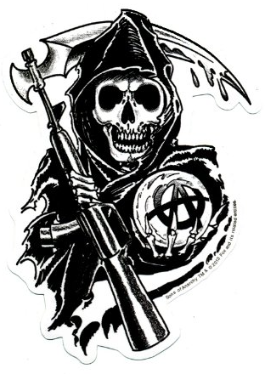
SONS OF ANARCHY
NEW JERSEY
PRESIDENT
OAK TREE
MEN OF MAYHEM
ORIGINAL
MC

